Slide 1
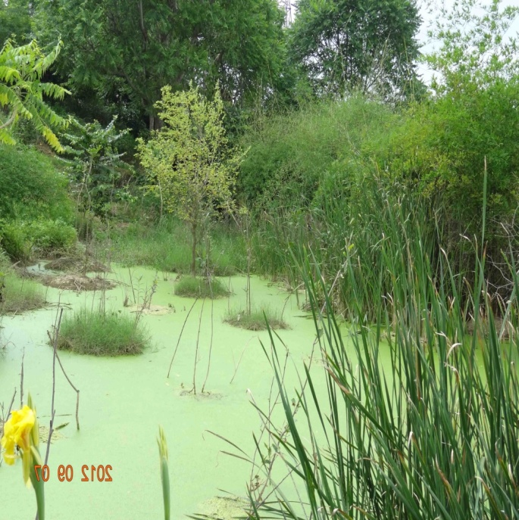
Wetland a major tool for rural development and river pollution control
By
Dinkar Saxena
CEO, Dass Rasayanic Services
Ashish Sharma & Virat Chawdhry
Scholars at Hindustan College of
Science & Engineering
, Farah, Mathura

Slide 2

We….
Author of this paper belongs to Dass Rasayanic Services and students of Hindustan college of science and technology, Mathura

Slide 3
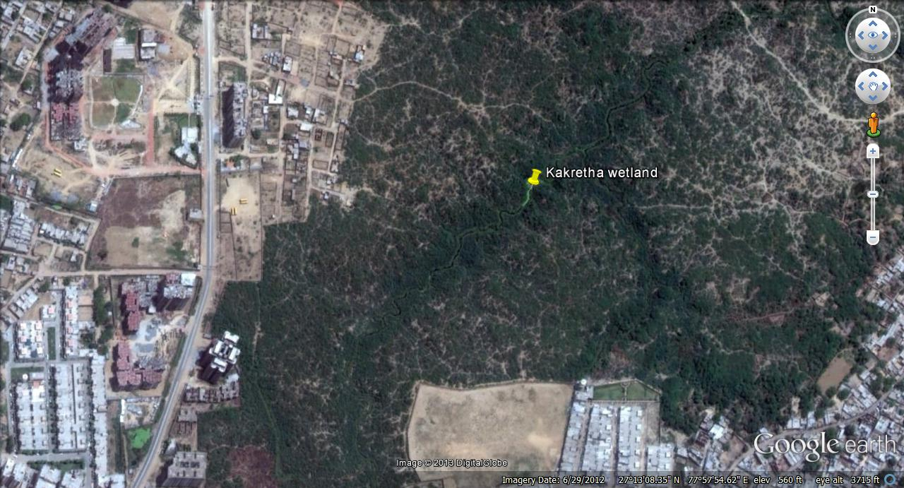
Environmental issue of Kakretha and Gailana……..
.
Gailana and Kakreta are the two villages in Agra near Yamuna River, with population density about 100 person/ha.
And generating around 5 mld of waste water, which is falling into Yamuna, unchecked.
From this site 8 drains carry the major amount of waste water up to the river.

Slide 4
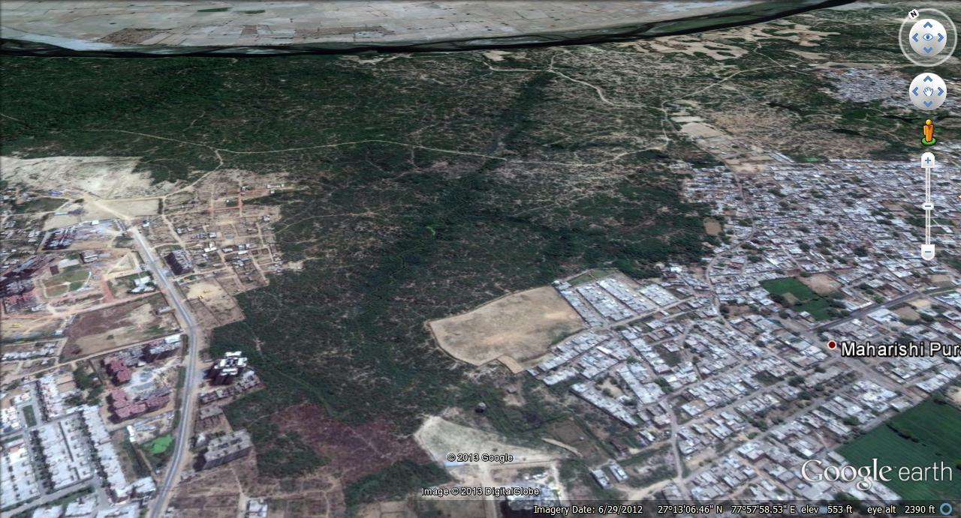
Environmental issue of Kakretha and Gailana……..
Impact of human settlement as increased storm runoff, due to paved or semi-paved areas, causing soil erosion in the watershed under study.
River pollution

Slide 5
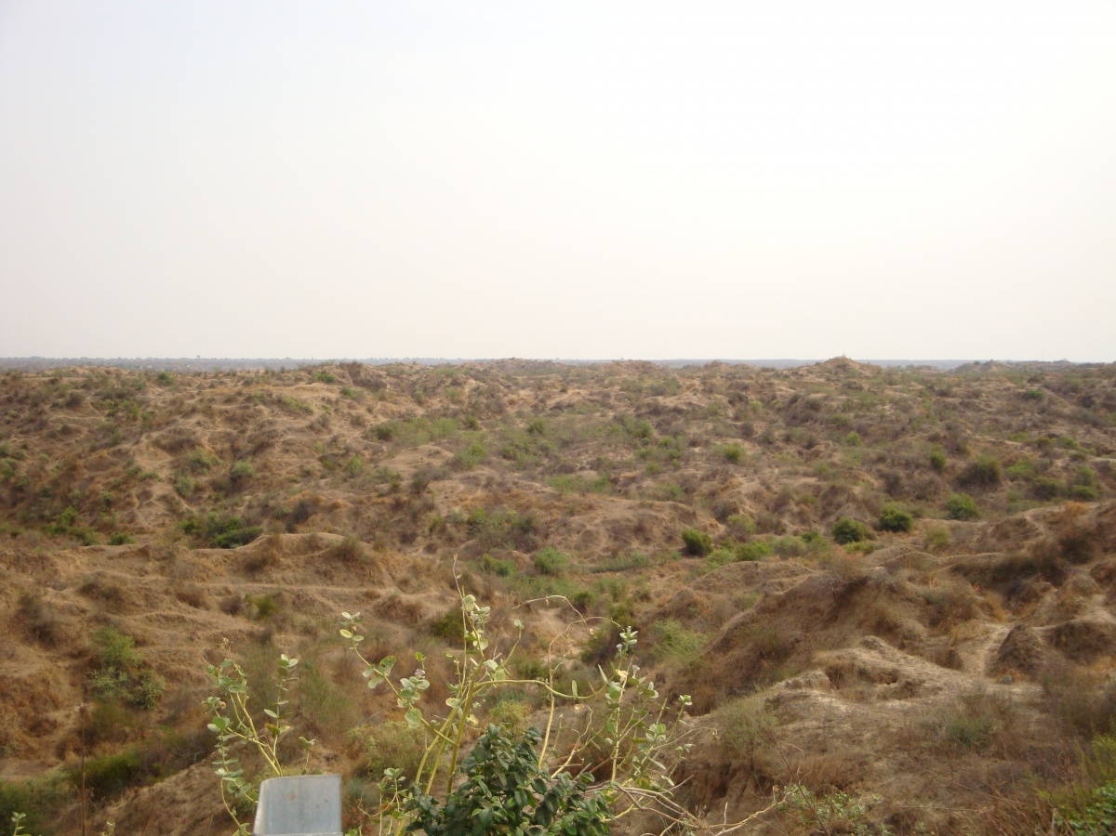
Base Line Conditions…
In post monsoon months there is hardly any moisture in soil.

Slide 6
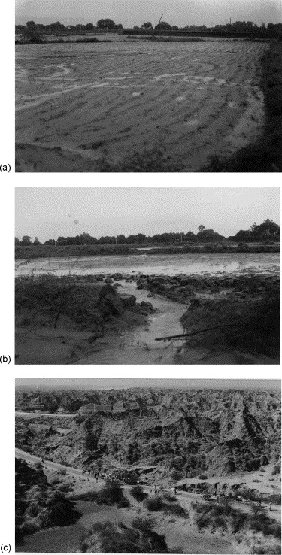
Base Line Conditions…
Due to very less vegetation in catchment area, absorption of water in soil is poor.
Catchment generates higher runoff resulting, soil erosion, thus ravines are formed as deep as 11 m due to unchecked runoff during the monsoon.

Slide 7
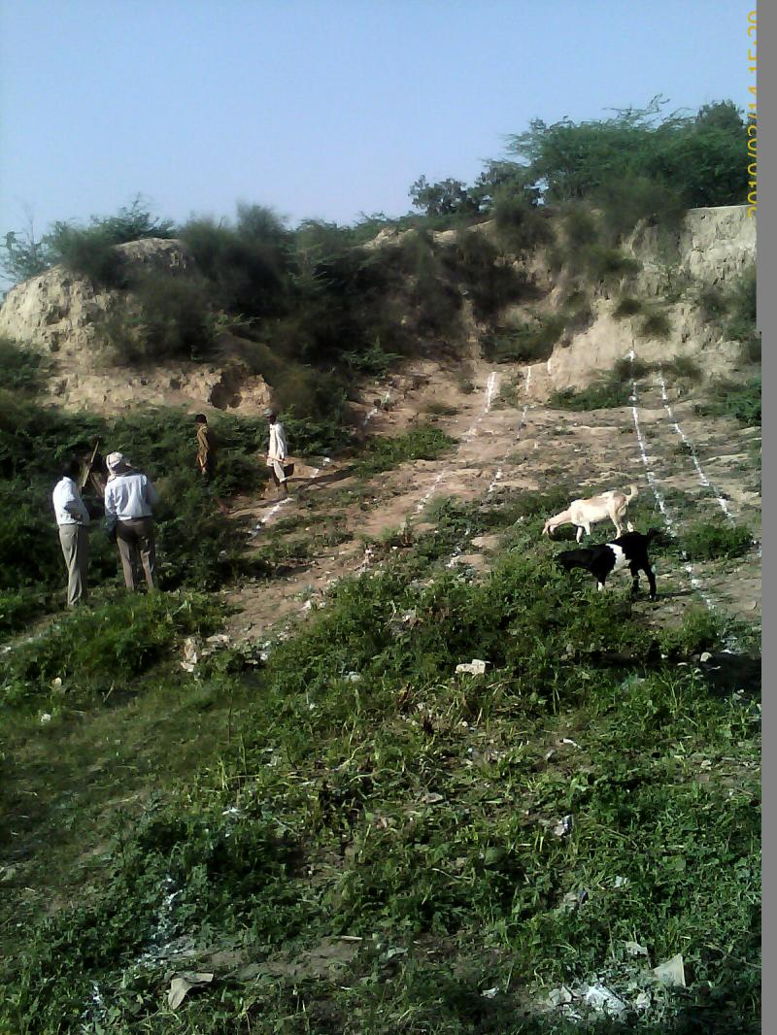
Base Line Conditions…
The catchment was used as grazing ground by Villages around it

Slide 8
Previous Efforts for restoration of ecology
Planation of Babool, a hardy plant, but requirement of firewood by nearby villagers destroys ecology.
Grazing of animals from nearby population and almost no moisture in soil has reduce plantation of grass
In year 2006 forest department installed earthen bunds, which could not survive due to flood and other factors.

Slide 9
Constraints for planning
Total budget allocated for the project was of Rs. 284 lakh.
The land has steep slopes with many depressions formed due to erosion
Although land belongs to forest department it was objected by the villagers, because it was used as a grazing site.
Entering of floating inorganic materials into the stream.
Rainfall runoff was to be utilized of a large area of 500ha.

Slide 10
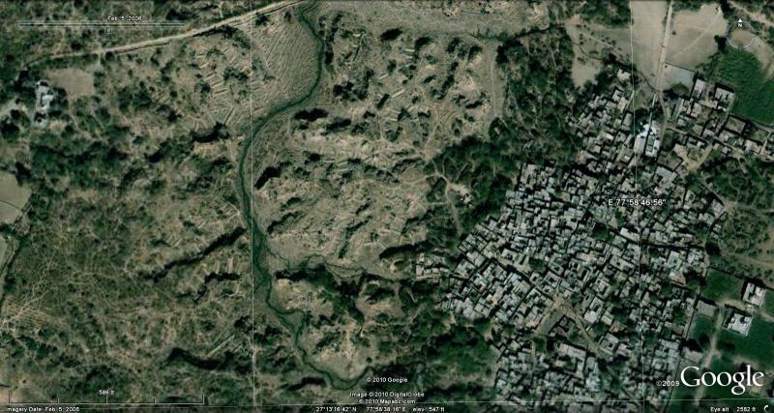
Terrain Description…
The surface has a steep fall of 11m from entrance to the discharge point and drain length was about nearly 3km.
Due to steep slopes of ravine and almost no vegetation there wasn’t any moisture in the soil.

Slide 11
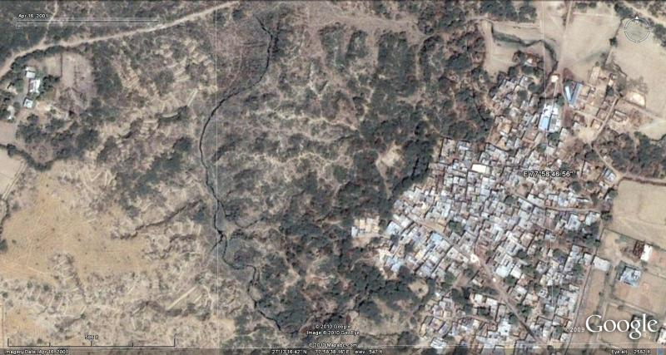

Slide 12
Possible mitigation measures…
Aerobic Treatment( mechanical aeration processes)
Anaerobic Treatment(waste water treatment plants)
Natural Treatment Processes( wetland etc.)

Slide 13
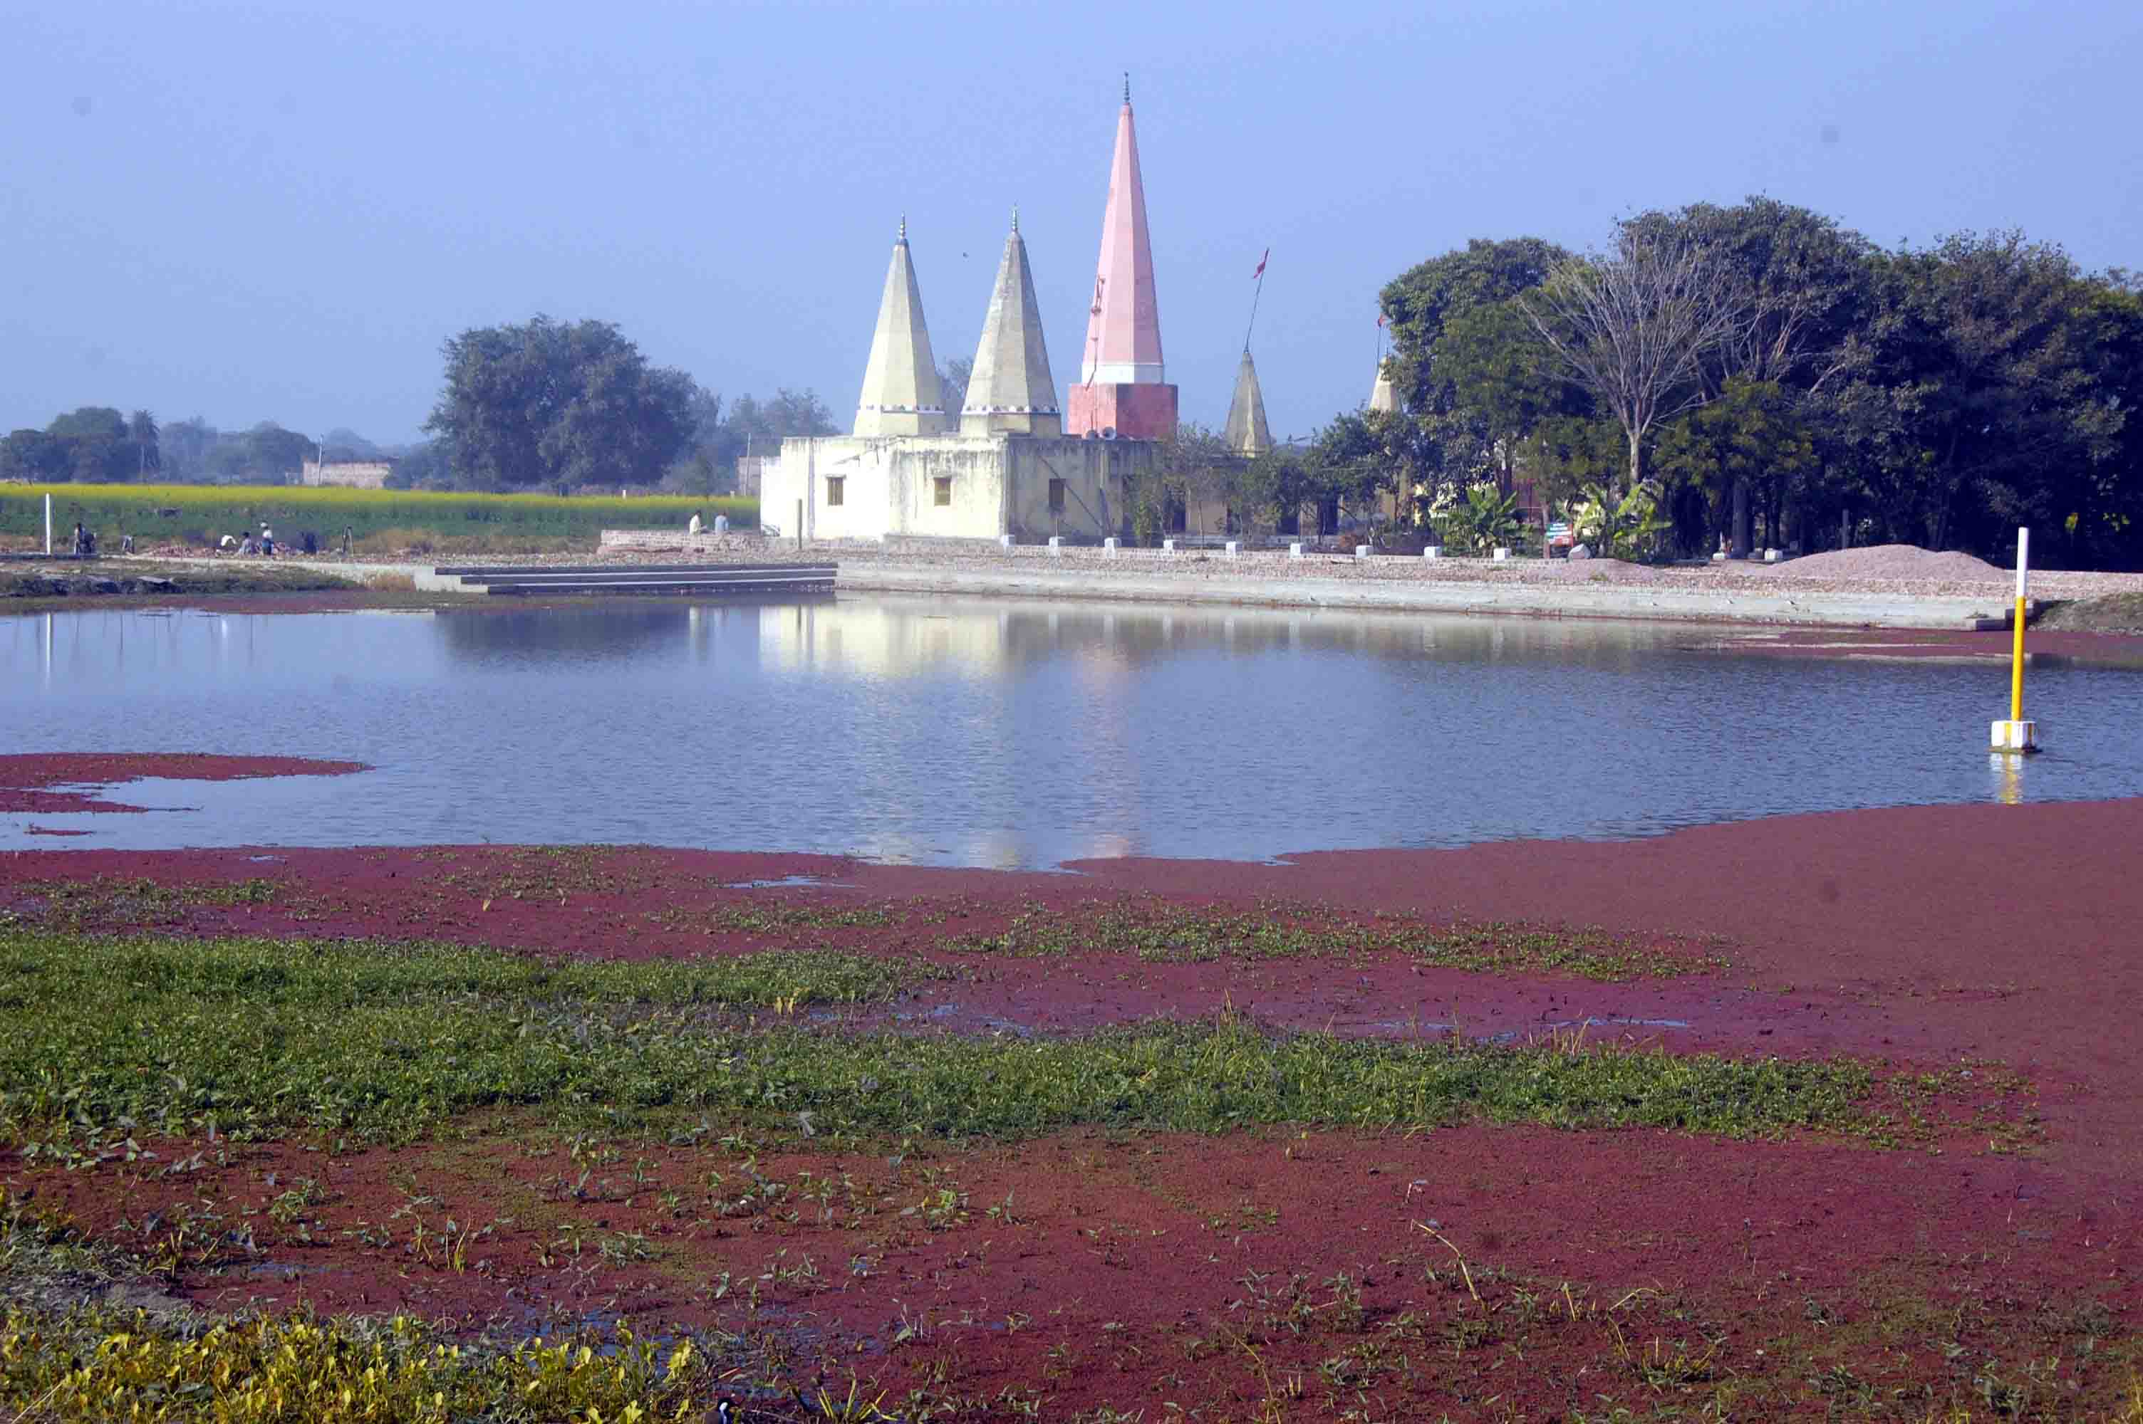
Wetland…
Definition
Generally, wetlands are lands where saturation with water is the dominant factor determining the nature of soil development and the types of plant and animal communities living in the soil and on its surface (Cowardin, December 1979).

Slide 14
Methodology adopted for designing
There are three types of constructed wetlands, using reed beds, are in use. All these systems are used commercially, usually together with septic tanks as primary treatment, Imhoff tanks or screeners in order to separate the solids from the liquid effluent).
Surface flow (SF) Constructed Wetland (or reed bed)
Sub Surface Flow (SSF) Constructed Wetland (or reed bed)
Vertical Flow (VF) Constructed Wetland (or reed bed)

Slide 15
Schematics …
Pre-treatment
Wetland
Discharge

Slide 16
Design considerations for wetland
Parameters | European Value | Recommended for India
Area requirement (m²/person⁽¹⁾) BOD₅ loading rate, g/m²-day⁽²⁾ Detention time, days Hydraulic loading rate, mm/day Depth of bed, meters Porosity of bed,%(typical) 1st Order reaction constant, K_{T}/day Evapotranspiration losses, mm/day⁽³⁾ | 2.0-5.0 7.5-12.0 2-7 (must not exceed hydraulic conductivity of bed) 10-15 | 1.0-2.0 17.5-13.5 2-3 0.6-0.9 30-40 0.17-0.18 >15
Source- Adapted from Arceivala and Asolekar, 2005
For the design of macrophyte beds with horizontal flow, two important aspects of design had been kept in mind. These are:
1. Organic removal parameter, and
2. Hydraulic flow considerations.

Slide 17
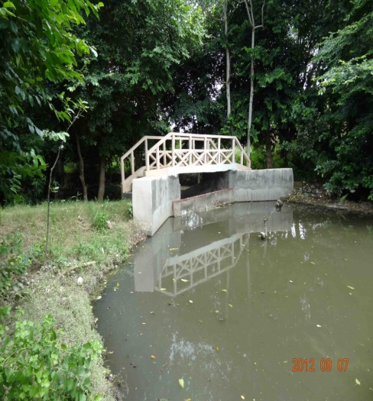
Pre-Treatment
Waste water reaching to the watershed, is pre-treated for the removal of unwanted and easily separable material

Slide 18
Design for organic removal:
BOD removal has been approximated by first order, plug flow kinetics:
C_{t}=C_{o}e^{-Kt}
Since t is a function of bed area, it can also written as
A= Q (ln C_{o} – ln C_{t})/ K_{BOD}
In which, A= bed area, m2
Q = average flow, m3/day
C_{o}= inlet 5-day BOD, mg/l
C_{t} = Outlet BOD₅, mg/l
K_{BOD} = BOD₅ reaction constant, day⁻¹
As per the Severn Trent report, the value of K_{T} for 49 systems in Denmark is observed to average 0.083 and in UK it is 0.067 per day. For Bangalore, India, with domestic wastewater Rengasami et al.(2002), the KT value as 0.17 per day which is likely to occur in a warm country.

Slide 19
Calculations
For Bed area
Catchment Area= 500ha approx.
Population= 100/ha average
Flow rate= 5 MLD expected
BOD= 200 mg/l
K_{BOD}= 0.17/day
A= Q (ln C_{o} – ln C_{t})/ K_{BOD}
As per Kinetic equation for first order reaction
A= 0.145(ln 200 –ln 30)/0.17 = 1.617 m² /person
Total Area required= 1.617x500x100=80850 m²
BOD load
BOD load per person= 200 mg/ltr x 145 ltr/day = 29 g/person/day
Hence BOD loading on bed = 29/1.617 = 17.93 g / m²/day
(This is within the recommended limit)

Slide 20
Mitigation employed on watershed
Calculation for area for wetland as per site conditions
Total gradient available is 11m
Total bed Area required ≈ 9.00 ha
Depth of each unit selected is 1m for reducing the cost of weir, thus total No of check dam can be constructed is 8 or max 9 or it requires 90000m² (approximately) / check dam.
At all the drains, development of 1 m deep ponding areas, by stone pitching at required Contours
A proper water segregation system is designed for separation of floating material, non-biodegradable garbage material in to wetland.

Slide 21
Mitigation employed on watershed
All the highland area is having contour bunds and rainwater recharging areas, thus reducing the runoff to valley or wetland area. Reducing the chances of wash off of wetland.
Three types of (non-predatory) fish are chosen to ensure that the fish can coexist & contribute to sustainable wetland ecology.
They are
1. Surface feeders
2. Middle-ground swimmers; and
3. Bottom scavengers

Slide 22
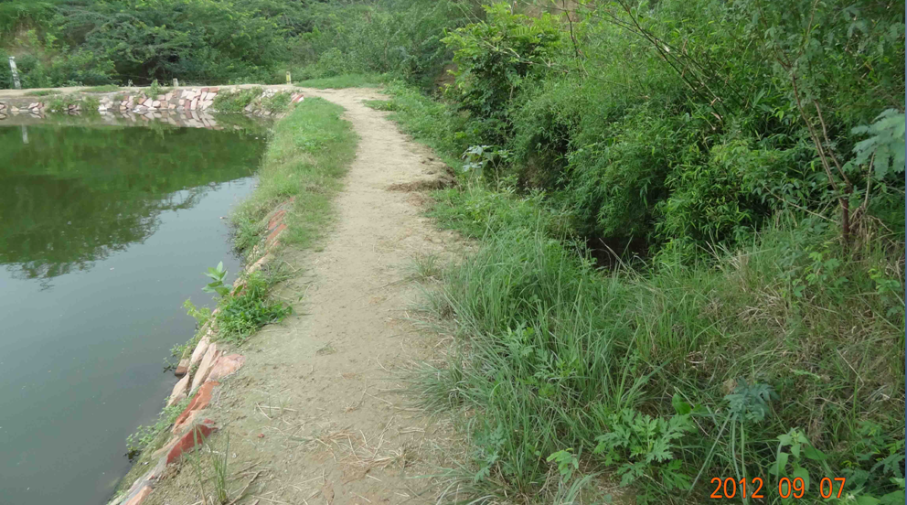
Present Scenario…
Restoration of wetland ecology: Bamboo has taken over the Babool.

Slide 23
Present Scenario…
BOD measured at the discharge point is measured is approximately 70% less than from the loading point.
Production of fish.
Increment in ground water level. Piezometer installed by forest department indicates 15 ft rise in ground water over these 4 years span
Control over Eutrophication

Slide 24
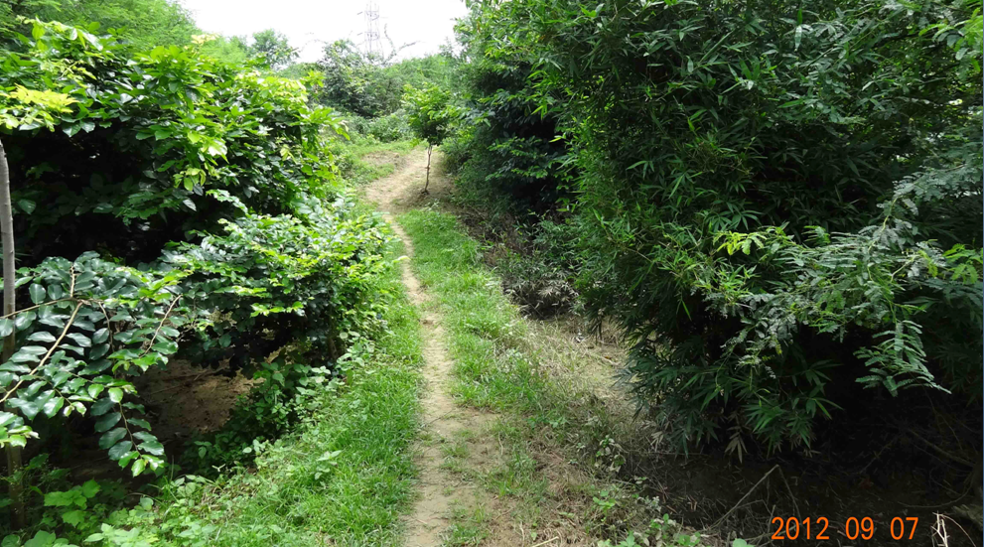
Present Scenario…
Increment of soil moisture regenerated the local vegetation such as Typha, Canna Indica, bamboo etc. Resulting Reduction of soil erosion.

Slide 25
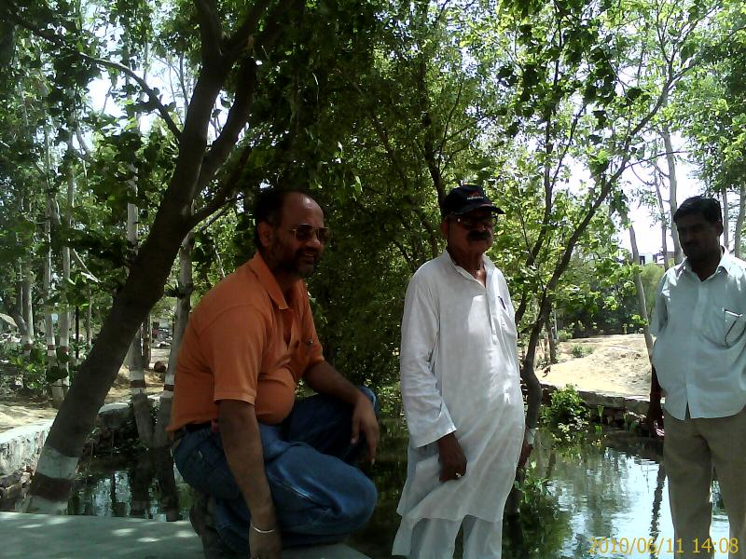
Developed forest land

Slide 26
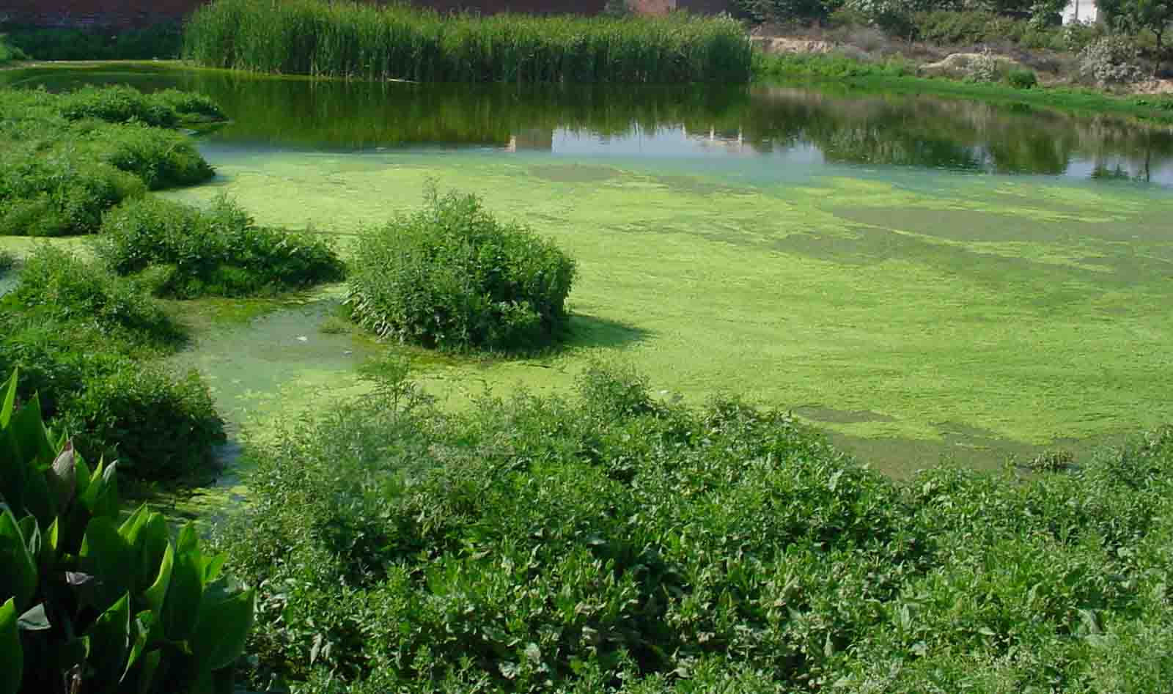
Formation of reed beds….

Slide 27
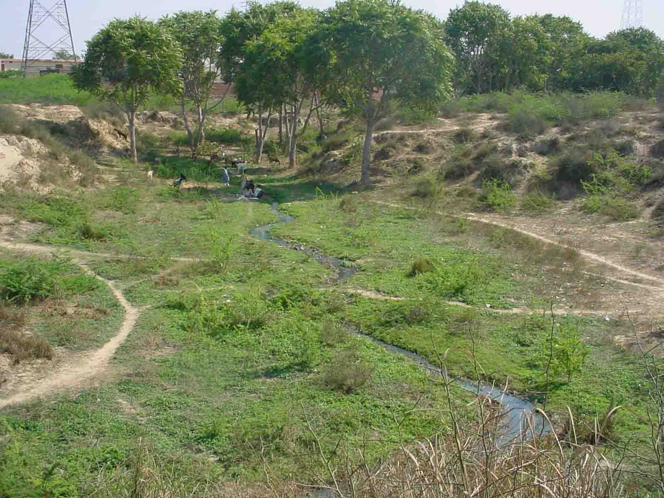
Results…..
Plate 1
Plate 2

Slide 28
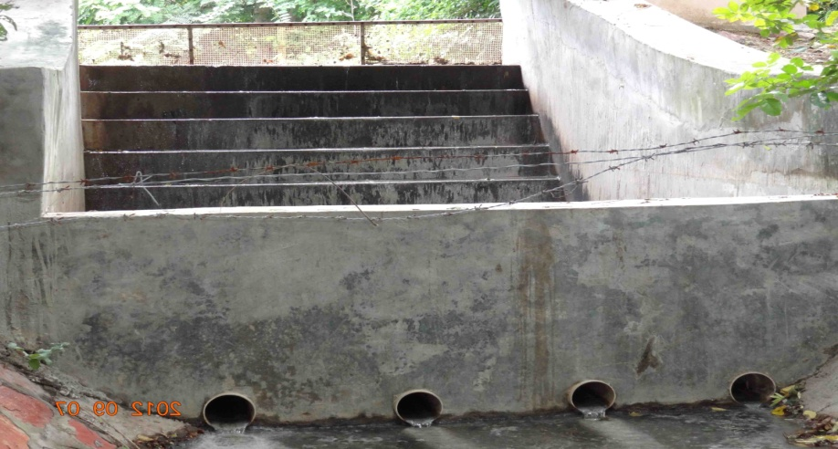
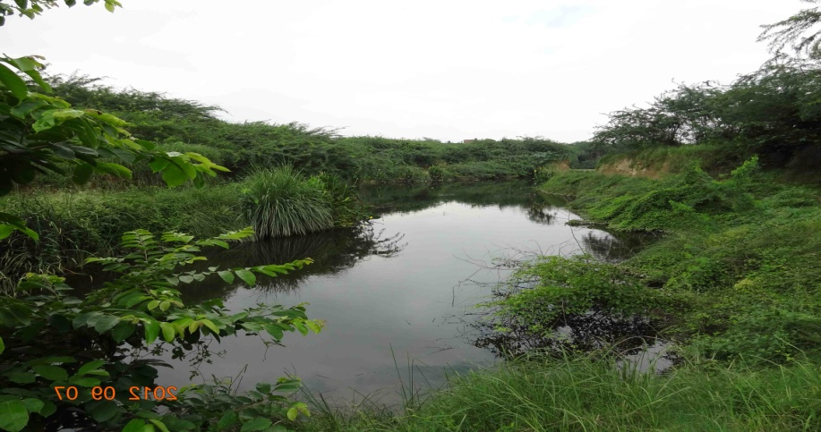
Results…
Plate 3 constructed check dam
Plate 4

Slide 29
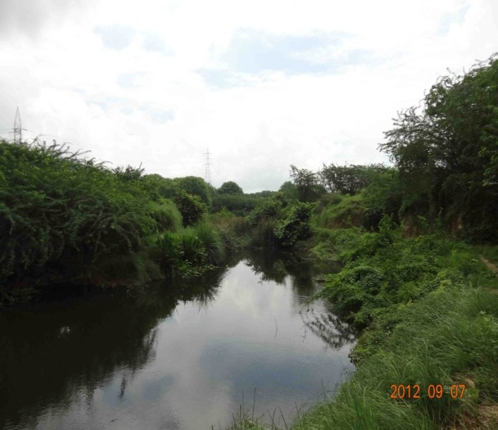
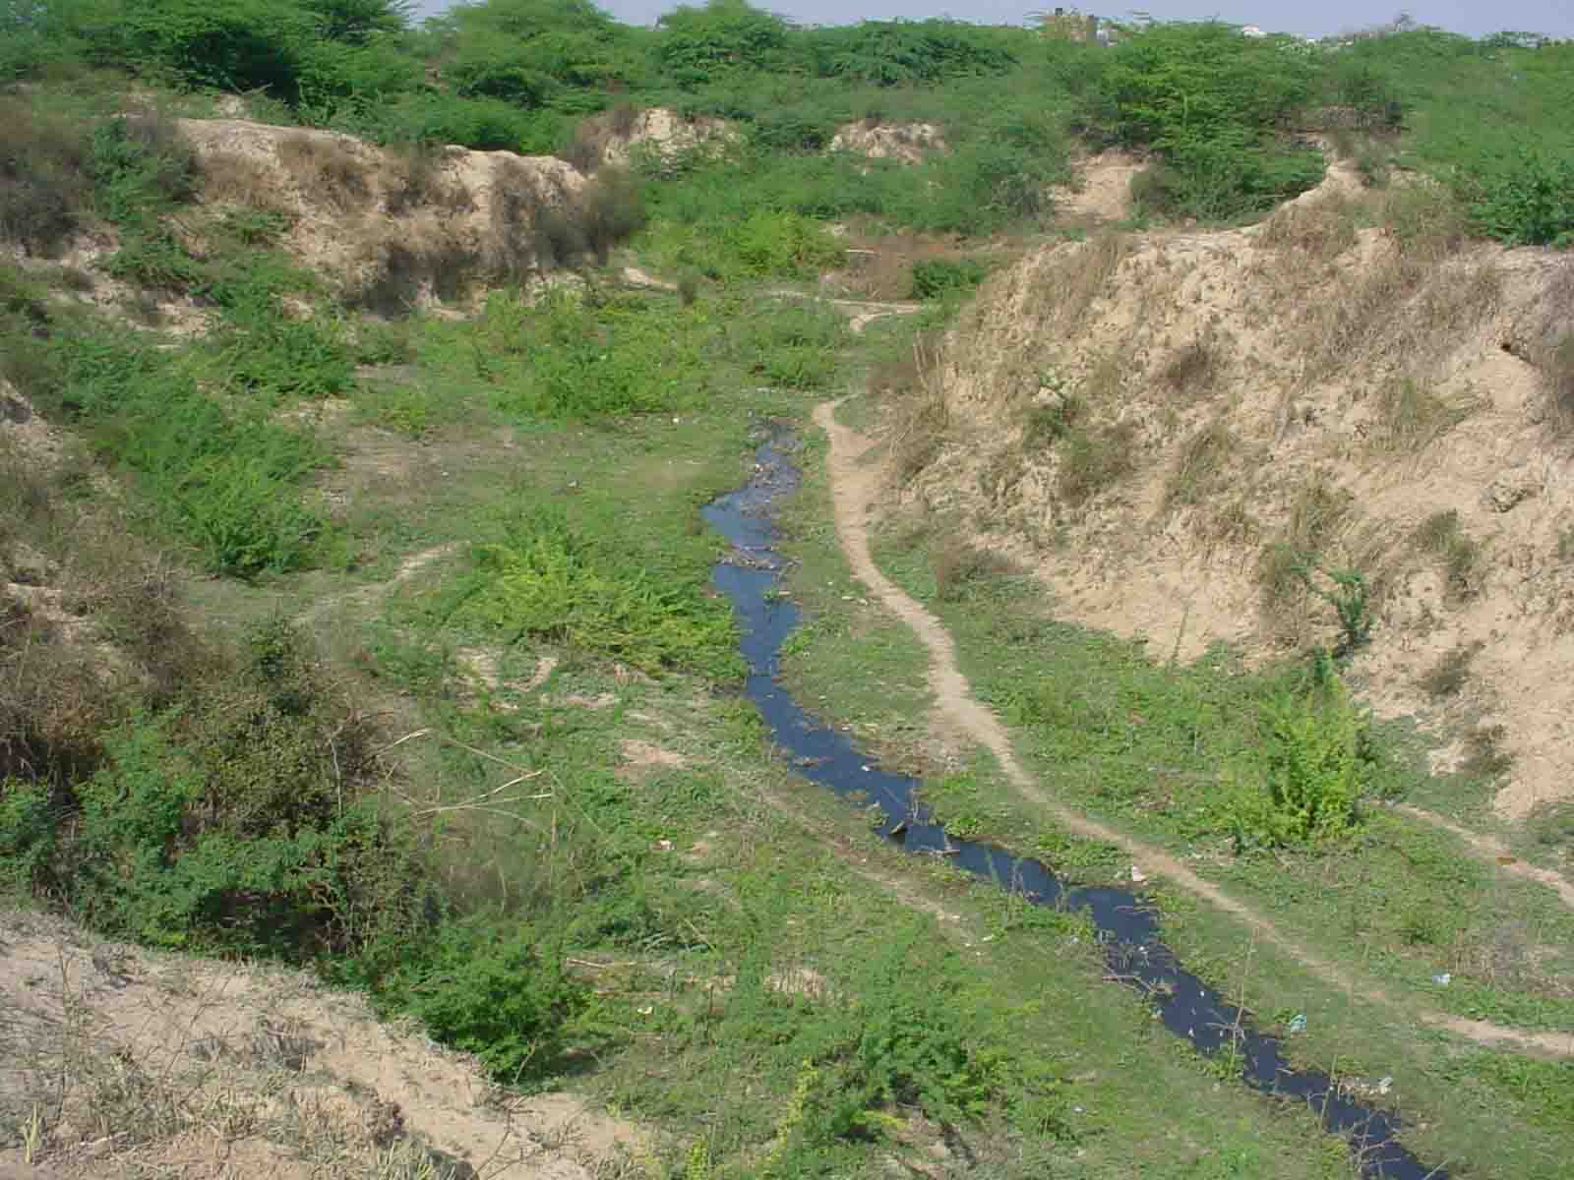
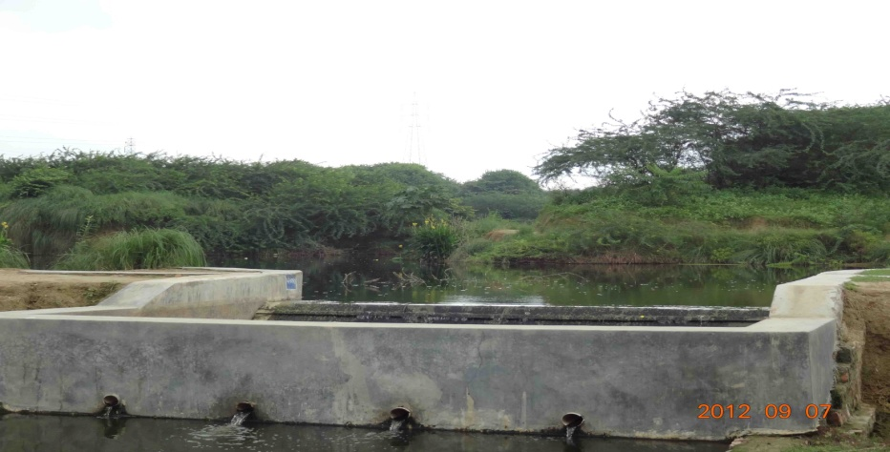
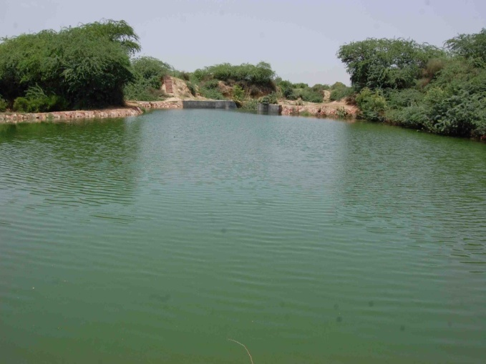
Results….
Plate 7 After construction
Plate 5 before construction (year 2009)

Slide 30
Google Images of site…..
Year….2005

Slide 31
At present…..

Slide 32
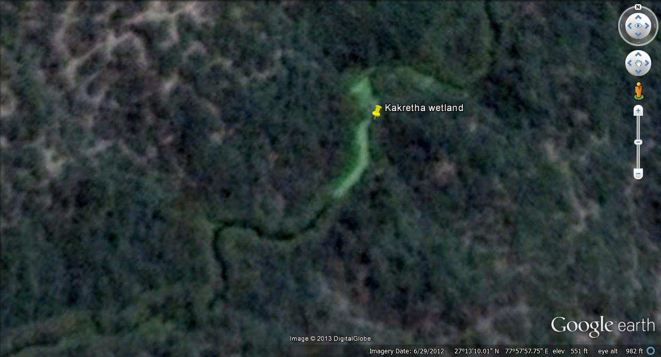

Slide 33
THANK YOU
FOR YOUR
ATTENTION

