Slide 1
WATERSHED MANAGEMENT IN URBAN PERSPECTIVE
ISSSUES DESIGN REQUIRMENT & MITIGATIONS
Dinkar Saxena
Chartered Engineer (India), M/128465/1
M. Sc., M.I.E., C. Eng., F.I.P.H.E., PGDM, MASHRAE
Environment Management System Auditor
Social accountability Auditor

Slide 2
WHAT IS WATRSHED…
Land area from which all water drains flow to a destination such as a river pond area from which all water drains, flow to a destination such as a river, pond, stream, lake, or estuary. It is a catchment basin that is bound by topographic features.

Slide 3
Watersheds…
Watersheds come in all shapes and sizes.
Watershed (ha) | Classification
50,000-2,00,000 | Watershed
10,000-50,000 | Sub-watershed
1,000-10,000 | Milli- watershed
100-1,000 | Micro-watershed
10-100 | Mini-watershed

Slide 4
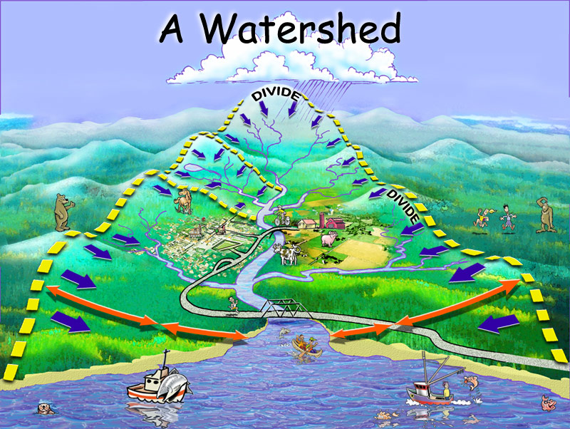

Slide 5
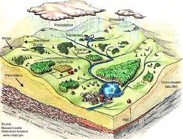

Slide 6
ET
Precipitation
Interception Storage
ET
Surface Storage
Surface Runoff
Infiltration
Interflow
Direct Runoff
Percolation
Baseflow
Groundwater Storage
Channel Processes
Flowchart of simple watershed model (McCuen, 1989)

Slide 7
Urban watershed management goals…
Water quality improvement
Flood hazard reduction
Stream and riparian restoration
Improve public awareness on waste management

Slide 8
Urban watershed issues..
Too little water
shortage
Polluted water
The discharges of wastewater by industry and households have considerable detrimental effects
on water quality and on public and ecosystem health.
Too much water
Frequencies increased or magnitudes of floods.

Slide 9
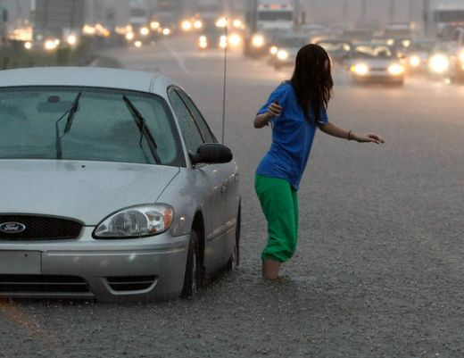
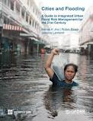
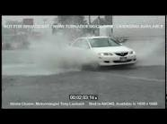
BUT Why we need it at all…?

Slide 10
Impacts of urbanization… Urbanization results in land development Increase in impervious areas
Altering stream channels and reduction in riparian corridor Results in increased run off carrying pollutants to receiving water bodies
Drains obstructed by service lines results Increased sediment yield and pollutants
Urban flooding
Overland flow of Wastewater from drains
Wet weather flow due to rainfall collects harmful organic and inorganic pollutants thus Receiving water bodies are badly affected

Slide 11
Focus on Key Issues…
Control and treatment of both wet dry weather flow
Efficient drainage and treatment system
Structural integrity of such system
Provision of traps for sediment collection
Real-time monitoring of water quality
Effect of these discharges in receiving water bodies
Preserve urban natural areas (public parks and green spaces)
How to reduce imperviousness in urban areas
Best management practices (BMPs)

Slide 12
Tools for urban watershed…

Slide 13
Development of Integrated Models for Urban Drainage Systems
1. Cities with Complex Drainage systems
2. Integrated management (Climate change, Pollution control, storm water and sewage network management and flood prevention)
3. The need of Decision support online
Need integrated complex models, using the advanced technologies GIS SCADA etc)
Modeling (geographic information system, supervisory control and data acquisition, etc.)
– GIS software
– model software
– Design of Drainage System

Slide 14
PRE-PROCESSING WITH GIS
A GIS is a computer system capable of capturing, storing, analyzing, and displaying geographically referenced information
GIS can display the Earth in realistic, 3D perspective views & animations that convey information more effectively
The main purpose of GIS analysis is to study the topographical characteristics of the study area which is further used for flood modelling
Clipping map as catchment shape
Making Terrain map with interpolation
Making grid-Raster data set
Exporting data set as Ascii file
3D representation of building within catchment area
3D representation of road network within catchment area

Slide 15
Rainfall data
Difference | Spatial scale | Temporal scale
River/watershed hydrology | large | year, day, hour
Urban hydrology | relative small | day, hour, minute

Slide 16
.. What is nature's way ? ..
Prior to urbanization, nature utilized the vegetation in the habitat (the leaves of trees etc.) to attenuate the run-off, encouraged evapo-transpiration and slowly recharged ground water aquifers via percolation *
..Spatially distributed system storage ..
Distributed Systems ?
Nature has evolved balanced hydrological and hydro -geological interactions with relatively SLOW DYNAMICS

Slide 17
Managing urban runoff…
Imperviousness in urban areas results in almost 10 times runoff as compared to vegetated area of same extend
Insufficient drainage capacity still the cause of urban flooding
New developments should focus on restoring vegetation in urban areas by constructing parks, planting roadside trees, preserving wetlands, protecting sensitive ecological areas etc.
A holistic approach for designing and laying storm water drains.
This should be as close to natural drainage pattern

Slide 18
Urban Drainage Concerns…
Now, drainage management includes – Additional goal of improving water quality
Is there an alternative, more sustainable way to approach the development of urban drainage?
Sustainability…
Making use of present resources without compromising their use for the future
Preserving the planet for the next generation
Helping the less fortunate to have a decent standard of living
Going back to BASICS and mimicking Nature's way by implementing controls as close to possible

Slide 19
BMPs…
Structural
Engineered devices implemented to control, treat, or prevent storm water runoff pollution.
Innovative mechanisms/devices
Stormwater ponds
Infiltration/ filtering systems
Open channels
Constructed treatment wetlands
Nonstructural
Alternative site design - rooftop runoff
Aquatic buffers
Non-stormwater discharges
Pollution prevention
Zoning and ordinances
Public education program and
Good management

Slide 20
Detention/Retention Ponds and Wetlands…
Detention/Retention ponds constructed along urban drainage systems to provide temporary storage for storm water peak flows, controlled pond outlet
Detention pond- dry between flood events
Retention pond- some water always (lake!)
Wetlands are retention ponds with plants
Reed family help in pollutant retention as well
temporary storing of storm water, reduce flow peaks, reduce the pipe size of downstream
reduce runoff pollution
rainwater reuse
Detention tank with multi-function(flood control, pollution control, rainwater reuse).

Slide 21
Shreeji Shivasha Mathura…
Separate storm water & sewage carrying system
Parks are designed _700 mm from road level. Providing almost 10 hrs. rain fall storage capacity at 80% of peak rainfall recorded.
All darins are terminating at nearest park or green area. Having well designed RWH tube settler, based settling system with Injection well.
There is overflow weir system is provided to prevent urban flooding .
For dry weather flow treatment STP is installed based on UASB followed by MBBR .
Treated wastewater is proposed to be utilized for plantation within the campus.

Slide 22
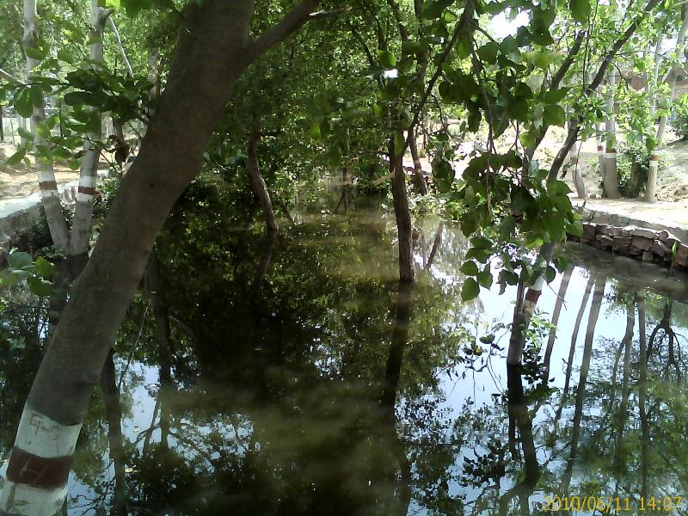
Kakretha Wetland…

Slide 23
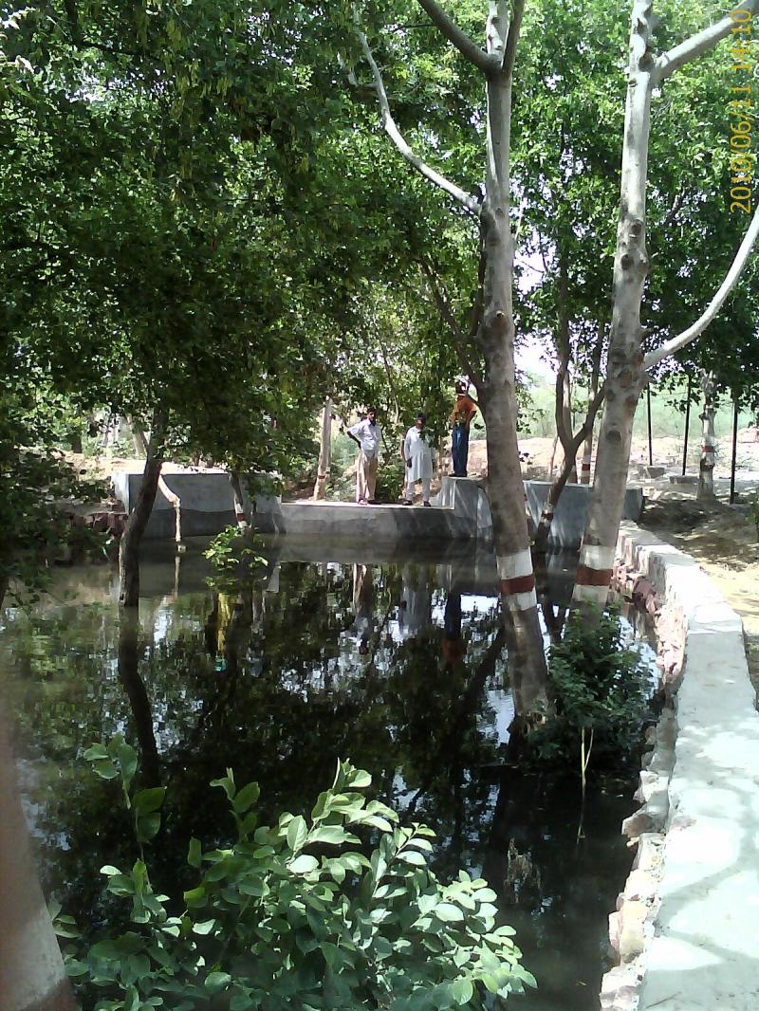

Slide 24
Challenges ahead…
Integrated development of water sector and sewage
How to provide optimal drainage capacity
Evolve technical guidelines for restoration and management of urban
streams and riparian
Formulate tools for effectively executing the planning, design, operation, and regulation of urban water resource projects
Urban watershed management goals
Water quality improvement
Flood hazard reduction
Stream and riparian restoration
Improve public awareness on waste management

Slide 25
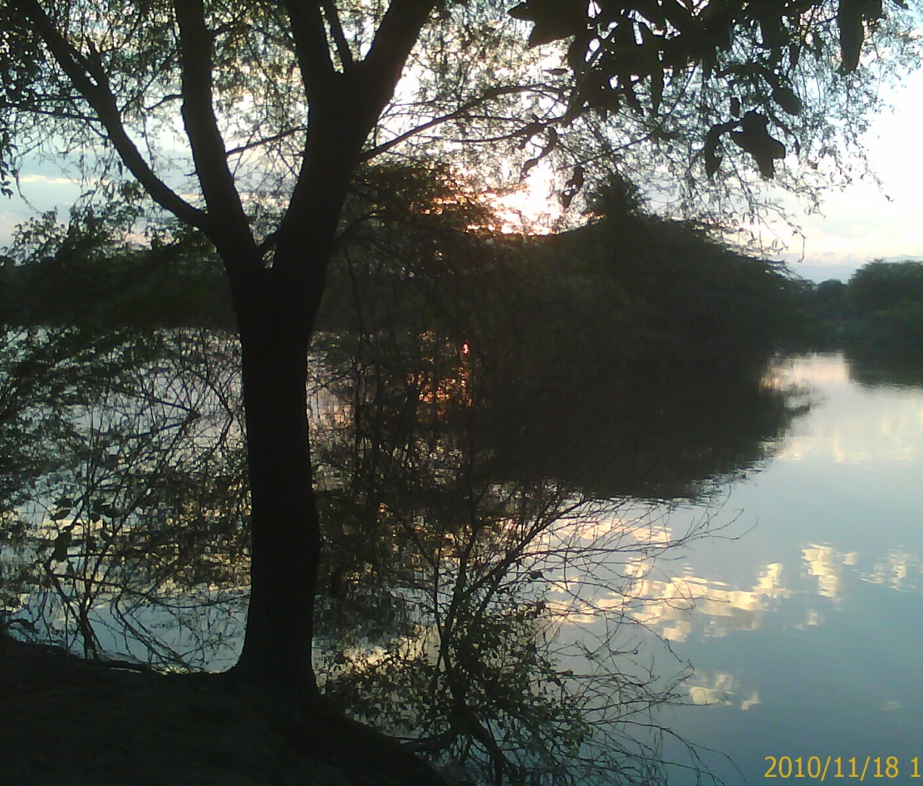
Thanks ….
For patient listening …
References
Urban Watershed Management, Dr. Sreeja P., Assistant Professor, Department of Civil Engineering, IIT Guwahati
*-integrated Watershed Management & Rainwater Harvesting
Prof. T. I. Eldho, Department of Civil Engineering, Indian Institute of Technology Bombay/ India.

